Slide 1
Predicting Diabetes Risk: Identifying Risk Factors
By Harshitha Atluri, Jean Paul Rajesh and Henry Berrios

Slide 2
TABLE OF CONTENTS
01
02
03
Introduction
Data Overview
Data Preprocessing
04
05
06
Exploratory Data Analysis
Model Selection And Evaluation
CONCLUSION
T
0

Slide 3
01
Introduction
T
1

Slide 4
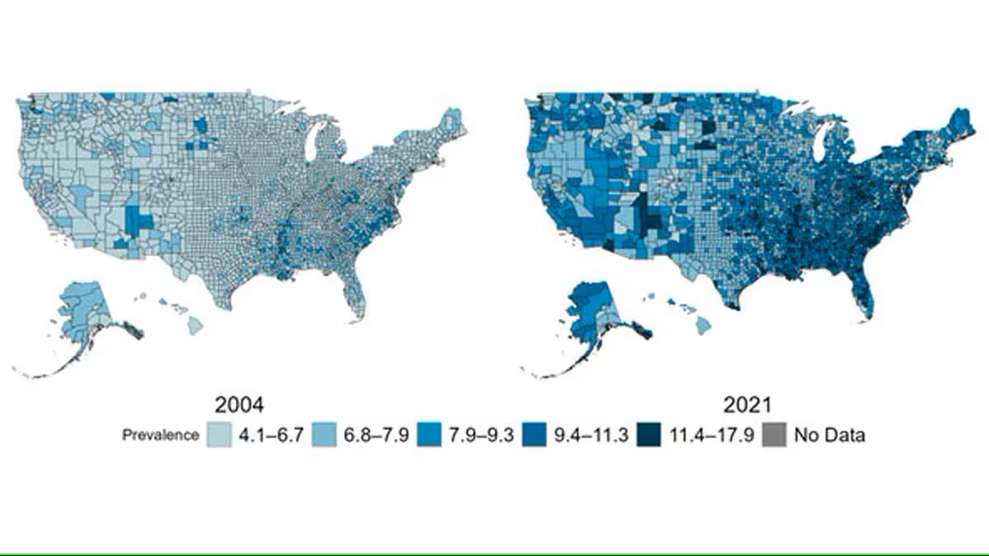
Introduction
136 million adults are living with diabetes or prediabetes in the U.S. (CDC, 2024)
Diabetes cost the U.S. Economy $413 billion annually, including medical costs and productivity
1 in 5 diabetics and 8 in 10 prediabetics are unaware of their condition
Prevalence of diagnosed diabetes, U.S., 2004 and 2021 (CDC, 2024)

Slide 5
Why it matters
prEVENTABLE COMPLICATIONS
Rising epidemic
Our goal
Diabetes-related compliations can be reduced with early detection
Diabetes prevalence has double over the last 20 years
Empowering healthcare providers with predictive tools and enable timely interventions
T
3

Slide 6
Research question
What are the most predictive risk factors for diabetes from the survey data?
T
2

Slide 7
02
Data Overview
T
3

Slide 8
Data Description
Source
Size
Target variable
CDC Behavioral Risk Factor Surveillance System (BRFSS)
2015
70, 692
Survey
responses
Diabetes_binary
(0 = No Diabetes,
1 = Prediabetes/Diabetes)
T
3

Slide 9
Predictors
Health Risk Factors
HighBP | History of BP | Binary
HighChol | History of High Cholesterol | Binary
CholCheck | Cholesterol check in 5 years | Binary
HeartDiseaseorAttack | History of heart disease or heart attack | Binary
Stroke | Diagnosed with stroke | Binary
Health Behaviors
Smoker | Smoked at least 100 cigarettes | Binary
PhysActivity | Engaged in physical activity in 30 days | Binary
Fruit | Consumes fruit | Binary
Veggies | Consumes vegetables | Binary
HvyAlcoholConsump | Heavy alcohol consumption | Binary
T
5

Slide 10
Predictors
Mental and Physical Health
BMI | Body Mass Index | Continuous
MentHlth | Days of poor mental health | Continuous
PhysHlth | Days of poor physical health | Continuous
Diff Walk | Difficulty walking or climbing stairs | Binary
GenHlth | General health rating | Ordinal
Demographics
Sex | Biological Sex | Binary
Age | Age category | Ordinal
Education | Education level | Ordinal
Income | Income scale | Ordinal
Access to Healthcare
AnyHealthcare | Has health coverage | Binary
NoDocbcCost | Could not see doctor due to cost | Binary
T
5

Slide 11
03
Data Preprocessing
T
4

Slide 12
STEPS TO Data Preprocessing
0 Duplicate rows
01
03
0 missing values
02
Categorical as factors
T
2

Slide 13
04
Exploratory data analysis
T
5

Slide 14
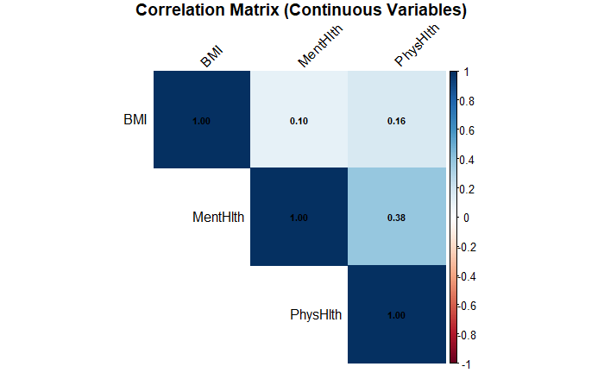
Correlation matrix
T
1

Slide 15
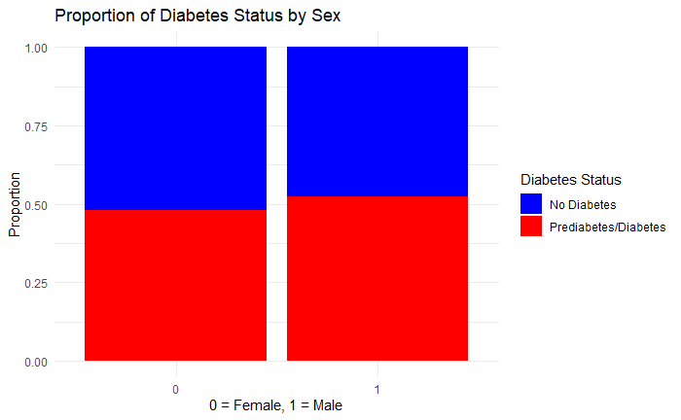
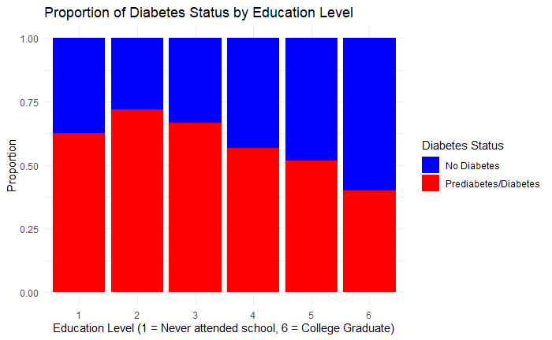
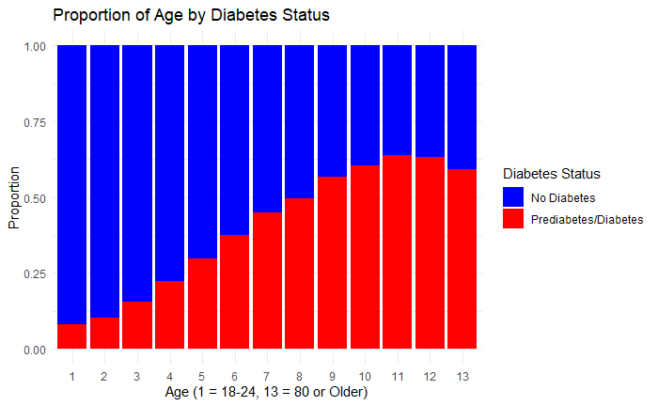
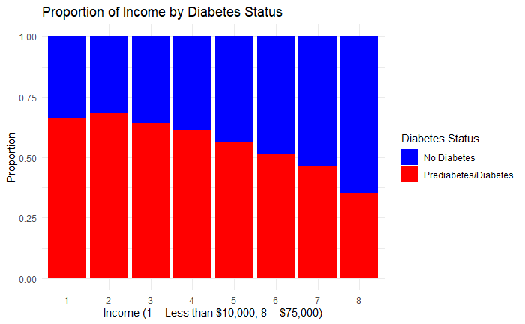
Demographics
T
1
Notes:
Diabetes prevalence increases with age and decreases with higher education and income levels. Males are slightly more affected than females

Slide 16
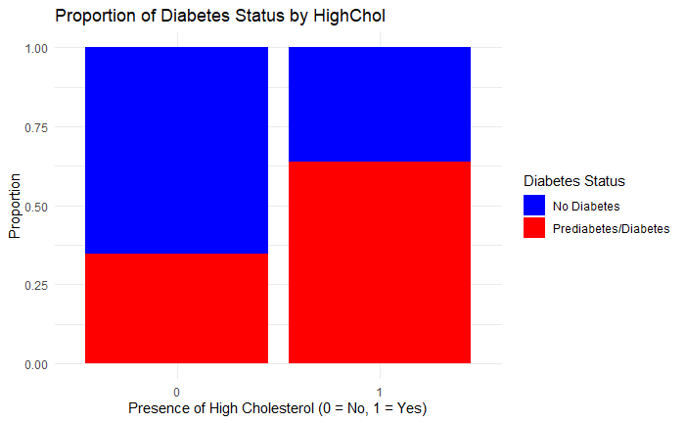
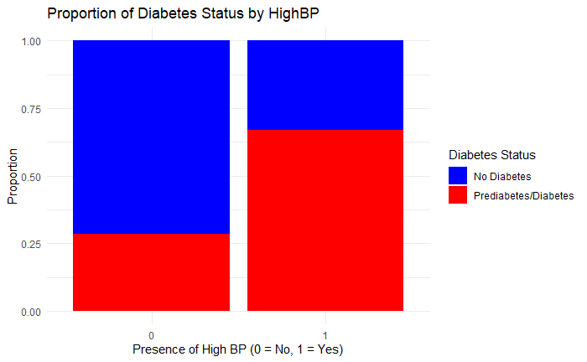
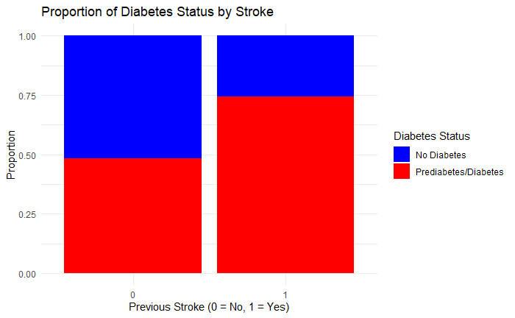
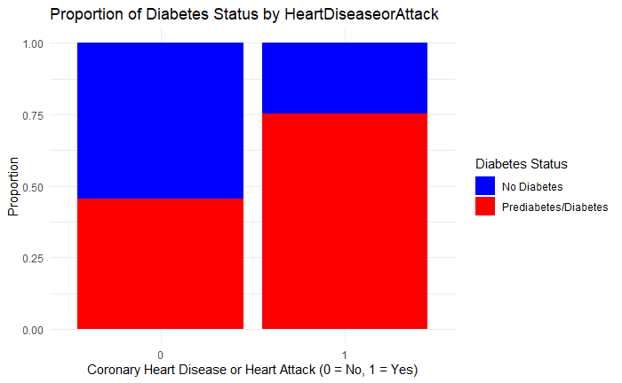
Health Risk Factors
T
1
Notes:
Key health conditions, including high blood pressure, high cholesterol, and cardiovascular diseases, show a strong association with diabetes risk

Slide 17
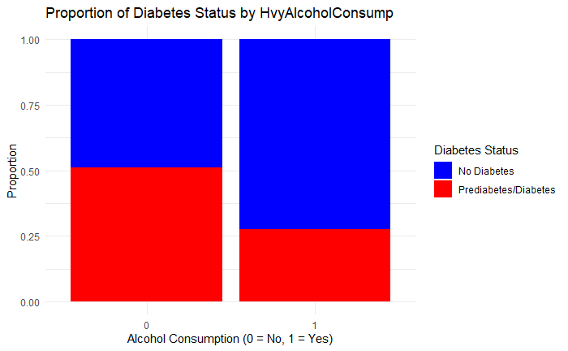
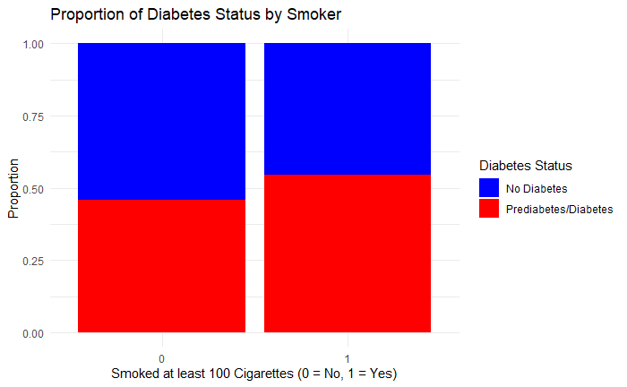
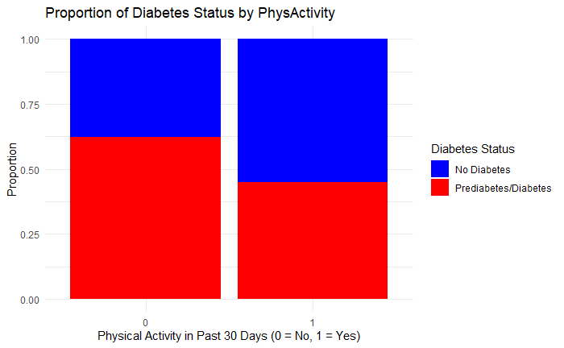
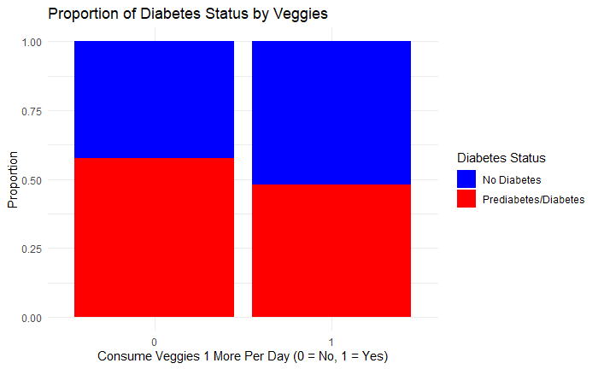
Health Behaviors
T
1
Notes:
Healthy behaviors such as physical activity and daily vegetable consumption are associated with lower diabetes prevalence. Conversely, smoking appears to increase diabetes risk

Slide 18
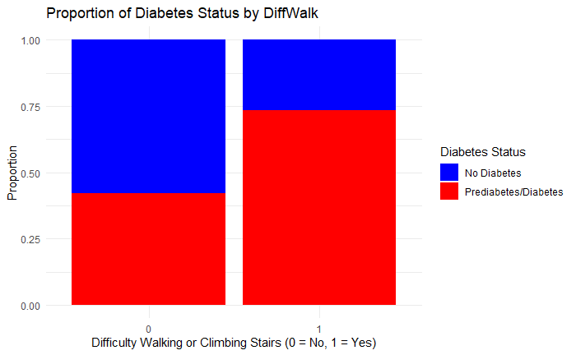
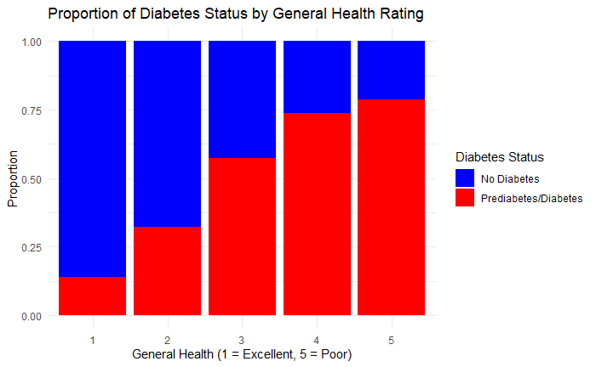
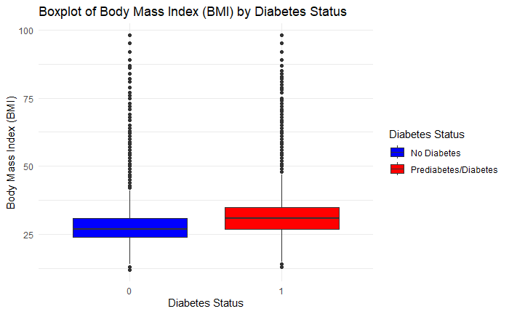
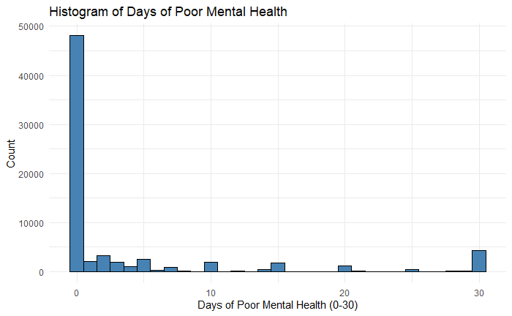
Mental and Physical Health
T
1
Notes:
Indicators of physical and mental health, including mobility challenges, higher BMI, and poorer general health, are strongly associated with diabetes prevalence. Poor mental health may also contribute to diabetes risk.

Slide 19
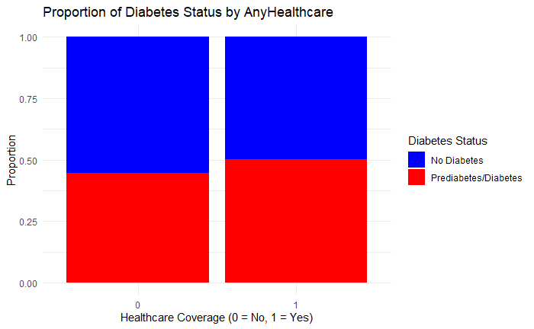
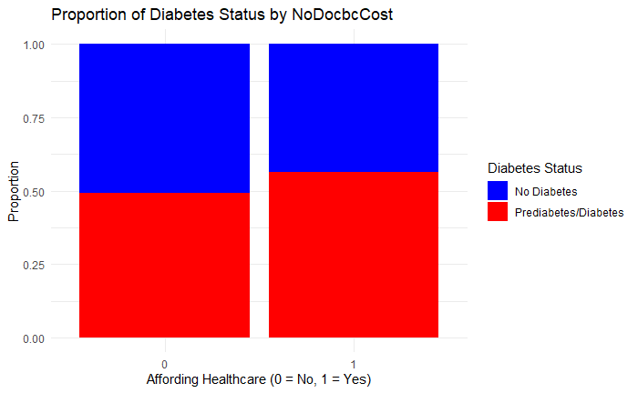
Access to healthcare
T
1
Notes:
While healthcare coverage alone may not directly influence diabetes prevalence, affordability plays a role in diabetes risk, emphasizing the need for equitable access to healthcare services.

Slide 20
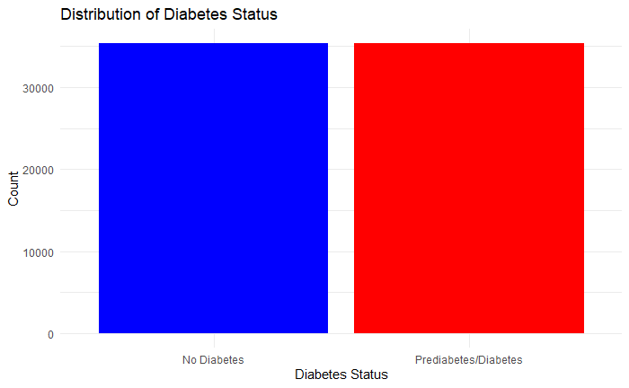
Diabetes PResence
T
1

Slide 21
05
Model Selection And Evaluation
T
2

Slide 22
Model Metrics
Models | Accuracy | Sensitivity | Specificity | F1-Score
Logistic Regression | 0.7505 | 0.7234 | 0.7776 | 0.7436
Decision Tree | 0.7290 | 0.6680 | 0.7901 | 0.7114
Random Forest | 0.7495 | 0.7145 | 0.7846 | 0.7405
* 80% Used for training, and 20% used for testing
T
3

Slide 23
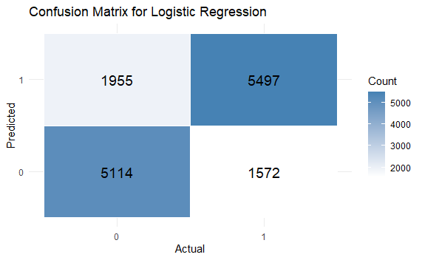
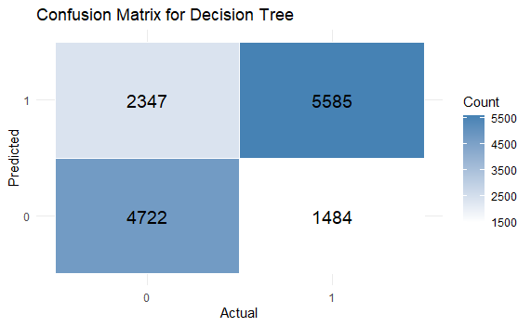
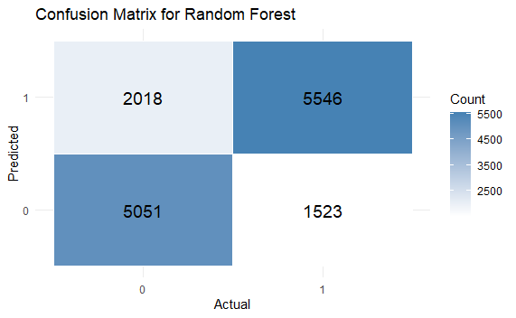
Confusion matrix
T
0

Slide 24
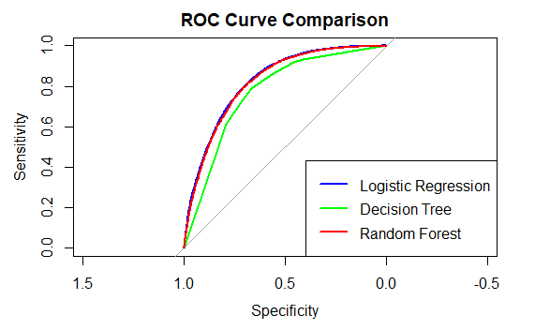
ROC Curve
T
2

Slide 25
Logistic regression coefficients
Health Factors
High Blood Pressure (↑ Risk)
High Cholesterol (↑ Risk)
High BMI (↑ Risk)
History of Stroke & Heart Disease (↑ Risk)
Behavioral Factors
Heavy Alcohol Consumption(↓ Risk)
General Health
Poor Self-Rated Health (↑ Risk)
Difficulty Walking (↑ Risk)
Demographics
Older Age (↑ Risk)
Male Gender (↑ Risk)
Lower Income & Education (↑ Risk)

Slide 26
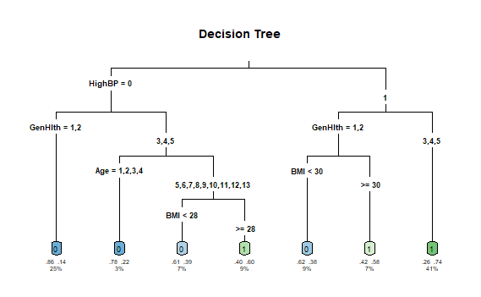
Decision tree
T
0

Slide 27
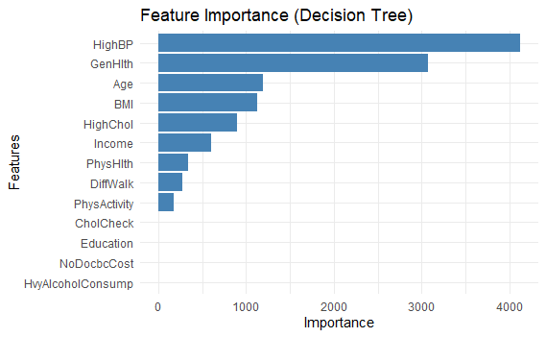
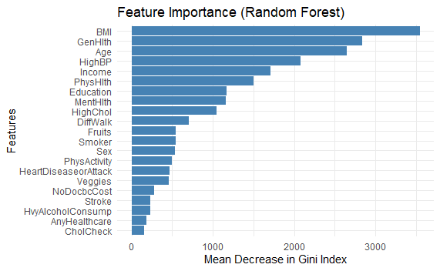
Feature importance
T
2

Slide 28
06
CONCLUSIONS
T
6

Slide 29
Conclusion
Key Predictors: High BMI, High Blood Pressure, Poor Self-Rated Health, and Age
Health Behaviors: Physical Activity and diet (fruits and vegetables) showed modest impact
Anomaly: Heavy alcohol consumption inversely correlated
All models should be used as they each provide valuable information
Logistic regression would be best if only one is chosen

Slide 30
Implications and Recommendations
Target high-risk groups and promote early screening and lifestyle interventions
Emphasize importance of health equity (for low income and lower-educated groups)
Incorporate geographic factors, or genetic predisposition
Health fairs in locations with high risk
Educate underserved populations about diabetes risk factors
Smaller, targeted set of questions could simplify data collection
Explore unexpected result with lower diabetes risk among high alcohol consumers

Slide 31
References
American Diabetes Association; Economic Costs of Diabetes in the U.S. in 2017. Diabetes Care 1 May 2018; 41 (5): 917–928. https://doi.org/10.2337/dci18-0007
Centers for Disease Control and Prevention. (2015). Behavioral Risk Factor Surveillance System (BRFSS). Retrieved from https://www.cdc.gov/brfss/
Centers for Disease Control and Prevention (CDC) (2010). Incidence of end-stage renal disease attributed to diabetes among persons with diagnosed diabetes --- United States and Puerto Rico, 1996-2007. MMWR. Morbidity and mortality weekly report, 59(42), 1361–1366.
Centers for Disease Control and Prevention. (2024). Data & research portal: Diabetes. Retrieved from https://www.cdc.gov/diabetes/php/data-research/index.html
Huxley, R., Barzi, F., & Woodward, M. (2006). Excess risk of fatal coronary heart disease associated with diabetes in men and women: meta-analysis of 37 prospective cohort studies. BMJ (Clinical research ed.), 332(7533), 73–78. https://doi.org/10.1136/bmj.38678.389583.7C
Knowler, W. C., Barrett-Connor, E., Fowler, S. E., Hamman, R. F., Lachin, J. M., Walker, E. A., Nathan, D. M., & Diabetes Prevention Program Research Group (2002). Reduction in the incidence of type 2 diabetes with lifestyle intervention or metformin. The New England journal of medicine, 346(6), 393–403. https://doi.org/10.1056/NEJMoa012512
Slidesgo. (n.d.). World Diabetes Day. Retrieved December 8, 2024, from https://slidesgo.com/theme/world-diabetes-day#search-diabetes&position-2&results-33&rs=search&rs=search
University of California, Irvine. (n.d.). CDC diabetes health indicators dataset. Retrieved December 8, 2024, from https://archive.ics.uci.edu/dataset/891/cdc+diabetes+health+indicators

